Slide 1
Congratulations, You’re in charge of a small district!
Chris Czerniak, CETL

Slide 2
Tell you what I have found
Give you some ideas to help you
Give you places for help
Let you know you’re not alone

Slide 3
Who am I?
Technology Director for Lake Mills Area School District for 12 years
Undergrad and Masters in Computer Information Systems
Worked in corporate world 8 years as helpdesk tech
Predecessor asked to leave
Four servers running Novell 6.5
First thing I did is reboot a server

Slide 4
What do I do now?
Run 3 VM hosts with
~30 Virtual Servers
Windows
Linux
1 to 1 2nd through 8th Grade
3 year rotation on Teacher machines
1 other tech
Mitel 3300 Phone system (3 servers)
~1500 students
~150 Staff
Helpdesk averaging 10 calls a day

Slide 5
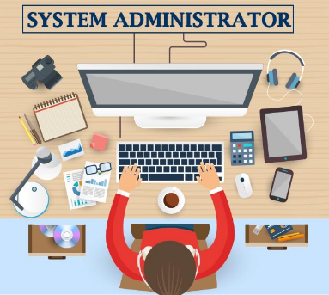

Slide 6
Things to do
Figure out what you have and what you are in charge of
Are you contracted out with any Vendors
Walk through buildings to see how technology is being used
Meet with building principals at least once a month
Meet with Administration team

Slide 7
Make a helpdesk
Phone calls get overwhelming
E-mails start to leave
Paper gets lost
Centralizes needs
Tracks Data
Spiceworks - https://www.spiceworks.com/free-help-desk-software/
OSticket - https://osticket.com/

Slide 8
E-Rate (https://www.usac.org/)
Figure out if your district is doing it (if not see if your eligible)
See who is doing it at your district and sit in with them for the 470 and 471
If it is only you - find a mentor to help you
Work with your Business manager

Slide 9
Tips and Tricks
Only take sales call one day a week during a certain time
Figure out what policies you have and what you need
Take some time to yourself
Reddit ( r/sysadmin r/techsupport r/k12sysadmin)

Slide 10
Brainstorm (You’re Here!!)
Talk to others in the session with you
Write down presenters who wanted to see but couldn’t
Get the slides
Come to the meet and greets
Find others like you

Slide 11
Other conferences and meetups
SLATE
ISTE
WETL (CoSN)
Wiscnet
Local Schools
Drop a line
Notes:
SLATE is a comprehensive educational technology convention designed to meet the needs of all schools and districts. This convention is designed for a wide variety of educators including Teachers, Principals, Associate Principals, District Administrators, Library Media Specialists, IT Coordinators, Directors of Curriculum and Instruction and other school leaders.
International Society for Technology in Education (ISTE), home to a passionate community of global educators who believe in the power of technology to transform teaching and learning, accelerate innovation and solve tough problems in education.
Wisconsin Educational Technology Leadership is the Wisconsin chapter of the Consortium for School Networking (CoSN). We provide resources and support to aid member districts in their goals to improve student outcomes through technology in the classroom. From strategic planning and policy implementation to IT Management, WETL can help your district overcome challenges associated with utilizing technology to help your students learn.

Slide 12
Other resources
Local or nearby Universities
Chris.Czerniak@lakemills.k12.wi.us
Vendors
Nearby Techs
WETL (www.wetlcosn.org)

Slide 13
Remember
You can’t make everyone happy
It is ok to say “no”
Do you the best you can
Call for help if you don’t know
It is ok not to know everything
Your Song
Your Day - Friday July 31, 2020 (System Administrator Day)

Slide 14
Your questions, answers, and tips

Slide 15
From the presentation (your ideas and suggestions)
Cyber Response Team - https://det.wi.gov/Pages/Cyber-Response-Teams.aspx
Wisconsin Student Privacy Alliance - https://sdpc.a4l.org/view_alliance.php?state=WI
Wisconsin DPI Data Privacy - https://dpi.wi.gov/wise/data-privacy
E-Rate - https://portal.usac.org/
Zenworks (imaging and much more)- https://www.microfocus.com/en-us/products/zenworks/overview

